Slide 1
CA 7503 Software Testing

Slide 2
Lecture 4 : Functional Testing

Slide 3
Testing questions
Should I test my own code, or should somebody else?
Which code of my project should I test the most/least?
Can I test all possible inputs to see whether something works?
How do I know if I've tested well/enough?
What constitutes a good or bad test case method?
Is it good or bad if a test case fails?
What if a test case itself has a bug in it?

Slide 4
Black and white box testing
What is the difference between black- and white-box testing?
Black-box (procedural) test: Written without knowledge of how the class under test is implemented.
focuses on input/output of each component or call
White-box (structural) test: Written with knowledge of the implementation of the code under test.
focuses on internal states of objects and code
focuses on trying to cover all code paths/statements
requires internal knowledge of the component to craft input
example: knowing that the internal data structure for a spreadsheet uses 256 rows/columns, test with 255 or 257
Notes:
(test case example: Microsoft Web Excel)

Slide 5
What is Functional Testing?
It is the testing based on the client requirements on how well it is functioning.
Example:
Field Level Validation
- Login field (username/password)
Business Level Validation
- Checking the rules of each is working or not
End to end flow
- whether the flow of data is proper.

Slide 6
Black Box Testing
Testing software against a specification of its external behavior without knowledge of internal implementation details
Can be applied to software “units” (e.g., classes) or to entire programs
External behavior is defined in API docs, Functional specs, Requirements specs, etc.
Because black box testing purposely disregards the program's control structure, attention is focused primarily on the information domain (i.e., data that goes in, data that comes out)
The Goal: Derive sets of input conditions (test cases) that fully exercise the external functionality

Slide 7
Black Box Testing
Black box testing tends to find different kinds of errors than white box testing
Missing functions
Usability problems
Performance problems
Concurrency and timing errors
Initialization and termination errors
Etc.
Unlike white box testing, black box testing tends to be applied later in the development process

Slide 8
The Information Domain: inputs and outputs
Inputs
Individual input values
Try many different values for each individual input
Combinations of inputs
Individual inputs are not independent from each other
Programs process multiple input values together, not just one at a time
Try many different combinations of inputs in order to achieve good coverage of the input domain
Ordering and Timing of inputs
In addition to the particular combination of input values chosen, the ordering and timing of the inputs can also make a difference.

Slide 9
The Information Domain: inputs and outputs
Defining the input domain
Boolean value
T or F
Numeric value in a particular range
99 <= N <= 99
Integer, Floating point
One of a fixed set of enumerated values
{Jan, Feb, Mar, …}
{Visa, MasterCard, Discover, …}
Formatted strings
Phone numbers
File names
URLs
Credit card numbers
Regular expressions

Slide 10
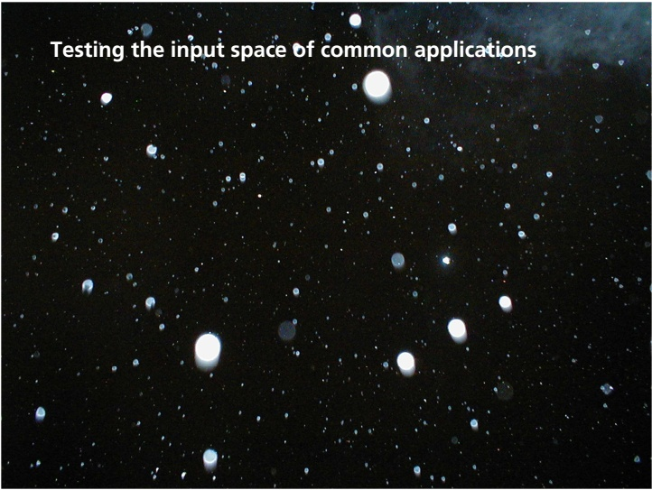

Slide 11
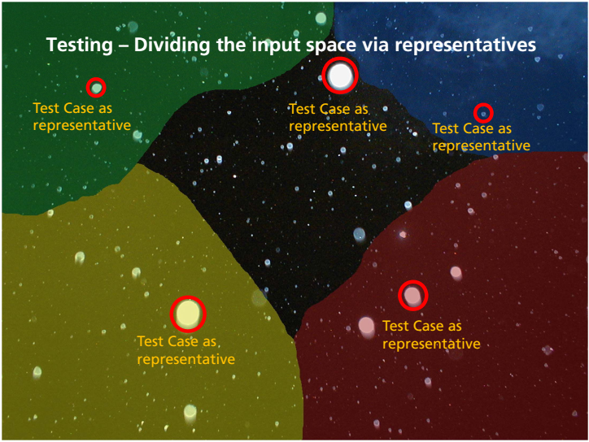

Slide 12
Functional Testing
Functional(specification based) testing
The system is considered as a “black box”
Only the external behavior (functionality) is known (the internal behavior is not)
Test goals: checking the existence of the specified functions and absence of extra functions.
Goals:
Based on the functional specification,
find representative inputs (test data) for testing the functionality.

Slide 13
Functional Testing
Overview of techniques:
Equivalence partitioning
Boundary value analysis
Cause-effect analysis
Combinatorial techniques

Slide 14
Equivalence Partitioning
Typically the universe of all possible test cases is so large that you cannot try them all
You have to select a relatively small number of test cases to actually run
Which test cases should you choose?
Equivalence partitioning helps answer this question

Slide 15
Equivalence Class Partitioning
Partition the test cases into "equivalence classes"
Each equivalence class contains a set of "equivalent" test cases
Two test cases are considered to be equivalent if we expect the program to process them both in the same way (i.e., follow the same path through the code)
If you expect the program to process two test cases in the same way, only test one of them, thus reducing the number of test cases you have to run.

Slide 16
Equivalence Class Testing
Motivation: we would like to have a sense of complete testing and we would hope to avoid test redundancy
Equivalence classes: partitions of the input set in which input data have the same effect on the program (e.g., the result in the same output)
Entire input set is covered: completeness
Disjoint classes: to avoid redundancy
Test cases: one element of each equivalence class
But equivalence classes have to be chosen wisely …
Guessing the likely system behavior is needed

Slide 17
Equivalence Partitioning
First-level partitioning: Valid vs. Invalid test cases
Valid
Invalid

Slide 18
Equivalence Partitioning
Partition valid and invalid test cases into equivalence classes

Slide 19
Equivalence Partitioning
Create a test case for at least one value from each equivalence class

Slide 20
Equivalence Partitioning
When designing test cases, you may use different definitions of “equivalence”, each of which will partition the test case space differently
Example: int Add(n1, n2, n3, …)
Equivalence Definition 1: partition test cases by the number of inputs (1, 2, 3, etc.)
Equivalence Definition 2: partition test cases by the number signs they contain (positive, negative, both)
Equivalence Definition 3: partition test cases by the magnitude of operands (large numbers, small numbers, both)
Etc.

Slide 21
Equivalence Partitioning
When designing test cases, you may use different definitions of “equivalence”, each of which will partition the test case space differently
Example: string Fetch(URL)
Equivalence Definition 1: partition test cases by URL protocol (“http”, “https”, “ftp”, “file”, etc.)
Equivalence Definition 2: partition test cases by type of file being retrieved (HTML, GIF, JPEG, Plain Text, etc.)
Equivalence Definition 3: partition test cases by length of URL (very short, short, medium, long, very long, etc.)
Etc.

Slide 22
Equivalence Partitioning
If an oracle is available, the test values in each equivalence class can be randomly generated. This is more useful than always testing the same static values.
Test Oracle: something that can tell you whether a test passed or failed
Test multiple values in each equivalence class. Often you’re not sure if you have defined the equivalence classes correctly or completely, and testing multiple values in each class is more thorough than relying on a single value.

Slide 23
Equivalence Partitioning - examples
Input | Valid Equivalence Classes | Invalid Equivalence Classes
A integer N such that: -99 <= N <= 99 | ? | ?
Phone Number Area code: [200, 999] Prefix: (200, 999] Suffix: Any 4 digits | ? | ?

Slide 24
Equivalence Partitioning - examples
Input | Valid Equivalence Classes | Invalid Equivalence Classes
A integer N such that: -99 <= N <= 99 | [-99, -10] [-9, -1] 0 [1, 9] [10, 99] | ?
Phone Number Area code: [200, 999] Prefix: (200, 999] Suffix: Any 4 digits | ? | ?

Slide 25
Equivalence Partitioning - examples
Input | Valid Equivalence Classes | Invalid Equivalence Classes
A integer N such that: -99 <= N <= 99 | [-99, -10] [-9, -1] 0 [1, 9] [10, 99] | < -99 > 99 Malformed numbers {12-, 1-2-3, …} Non-numeric strings {junk, 1E2, $13} Empty value
Phone Number Area code: [200, 999] Prefix: (200, 999] Suffix: Any 4 digits | ? | ?

Slide 26
Equivalence Partitioning - examples
Input | Valid Equivalence Classes | Invalid Equivalence Classes
A integer N such that: -99 <= N <= 99 | [-99, -10] [-9, -1] 0 [1, 9] [10, 99] | < -99 > 99 Malformed numbers {12-, 1-2-3, …} Non-numeric strings {junk, 1E2, $13} Empty value
Phone Number Area code: [200, 999] Prefix: (200, 999] Suffix: Any 4 digits | 555-5555 (555)555-5555 555-555-5555 200 <= Area code <= 999 200 < Prefix <= 999 | ?

Slide 27
Equivalence Partitioning - examples
Input | Valid Equivalence Classes | Invalid Equivalence Classes
A integer N such that: -99 <= N <= 99 | [-99, -10] [-9, -1] 0 [1, 9] [10, 99] | < -99 > 99 Malformed numbers {12-, 1-2-3, …} Non-numeric strings {junk, 1E2, $13} Empty value
Phone Number Area code: [200, 999] Prefix: (200, 999] Suffix: Any 4 digits | 555-5555 (555)555-5555 555-555-5555 200 <= Area code <= 999 200 < Prefix <= 999 | Invalid format 5555555, (555)(555)5555, etc. Area code < 200 or > 999 Area code with non-numeric characters Similar for Prefix and Suffix

Slide 28
Functional equivalence class construction
Principle: Reduce complexity until a rather easy selection of test cases is possible.
Result: Set of “equivalence classes”
Set of data, for which the system shows the same reactions
Every single value of a certain equivalence class is seen as representing all values in this equivalence class
Approach: continuous case differentiation

Slide 29
Functional equivalence class construction
Case differentiation
Regarding input and output conditions
Example: A specification demands positive values as input for a certain function
Case differentiation
Positive input
Non-positive input
We can differentiate between valid and invalid equivalence classes
In this example:
Positive values = valid equivalence class ( i.e., as specified / expected)
Non-positive values = invalid equivalence class

Slide 30
Functional equivalence class construction
Case differentiation regarding
Input: as seen
Output: differentiation of output classes
Choose values as input which create output in the chosen equivalence class
Example: Specification: output = 1<= X <= 99
One valid equivalence class
Each input which creates an output between 1 and 99
Two invalid equivalence classes
Each input which creates an output smaller than 1
Each input which creates an output greater than 99

Slide 31
Functional equivalence class construction
Based on these equivalence classes choose test cases
Use Boundary value analysis
Test the boundaries of equivalence classes
Experience shows: Faulty behavior is often produced when values are on the boundary of an equivalence class
Possible addition:
Test of special values, like “0”
Choose values randomly

Slide 32
Functional equivalence class construction
Rules for constructing equivalence classes:
If an input condition specifies a value range, one valid and two invalid equivalence classes are to be formed
If an input condition specifies a number of values, one valid and two invalid equivalence classes are to be formed
If an input condition specifies a quantity of values which are to be processed differently, a separate valid equivalence class has to be formed for each value. For all other values except the valid values one invalid equivalence class is to be formed.
If an input condition specifies a certain situation which must be fulfilled, one valid and one invalid equivalence class are to be formed.

Slide 33
Functional equivalence class construction
Example: “stringed instruments: guitar, violin, viola, bass”
Four valid equivalence classes: guitar, violin, viola, bass
One invalid equivalence class: everything else, e.g. piano, drums, …
Rules to be followed
Functions receiving input from input-/ output-channels
Form valid and invalid equivalence classes
Reason: error handling routines for invalid input must be implemented
Subordinate functions
Comply to limitations regarding input
Calling function may already implement error handling routines
Subordinate function is likely to NOT implement an additional error handling
Would lead to dynamically unreachable code
Dependencies between input values
Some combinations of input values may not be applicable

Slide 34
Functional equivalence class construction
Two rules
Derive test cases regarding valid equivalence classes by selecting test data from as many valid equivalence classes as possible
Reduces number of test cases regarding valid equivalence classes to a minimum
Derive test cases regarding invalid equivalence classes by combining test data from exactly one invalid equivalence class with test data from valid equivalence classes
When using two or more invalid input values at the same time, which value caused the error handling to be processed?

Slide 35
Functional equivalence class construction
Example – Specification
A routine of a booking system computes invoices from private and business customers.
For computing, the system requires the customer ID, the invoice amount, and the receipt of payment.
Invoice amount and receipt of payment are positive numbers (minimum is one) without leading zeros, limited to six digits.
Customer IDs start with a “P” for private or a “B” for business customers.
The routine produces true, if the receipt of payment is equal to or greater than the invoice amount. The routine produces false, if the receipt of payment is less than the invoice amount.

Slide 36
Functional equivalence class construction
Example – Specification
A routine of a booking system computes invoices from private and business customers.
For computing, the system requires the customer ID, the invoice amount, and the receipt of payment.
Invoice amount and receipt of payment are positive numbers (minimum is one) without leading zeros, limited to six digits.
Customer IDs start with a “P” for private or a “B” for business customers.
The routine produces true, if the receipt of payment is equal to or greater than the invoice amount. The routine produces false, if the receipt of payment is less than the invoice amount.
Description: Blue and Bold: values; Red and Italic: conditions

Slide 37
Functional equivalence class construction
Example – Constructing equivalence classes
Variable | Valid equivalence classes | Invalid equivalence classes
Customer ID | 1)P123 2)B135 | 3) D123
Invoice amount | 4) 1 <= IA <= 999999 | 5) IA <= 0 6) IA > 999999
Receipt of payment | 7) 1 <= RoP <= 999999 | 8) RoP <= 0 9) RoP > 999999
Routine | 10) True (RoP >= IA) | 11) False (RoP < IA)

Slide 38
Functional equivalence class construction
Example – Creating test cases with boundary value analysis
Test case | Equivalence classes used | Customer ID | Invoice amount | Receipt of Payment | Routine
1 | 1, 4L, 7U, 10 | “P123” | 1 | 999999 | True
2 | 2, 4U, 7L, 11 | “B135” | 999999 | 1 | False
3 | 3 | “D123” | 1 | 1 | -
4 | 5 | “P123” | 0 | 1 | -
5 | 6 | “P123” | 1000000 | 1 | -
6 | 8 | “P123” | 1 | 0 | -
7 | 9 | “P123” | 1 | 1000000 | -
Most test cases are negative (i.e., they produce an error)!
U: Upper bound L: Lower bound Red and Bold: Values from invalid equivalence classes

Slide 39
Example: Testing a triangle analyzer
Program specification:
Input: 3 numbers separated by commas or spaces
Processing:
Determine if three numbers make a valid triangle; if not, print message NOT A TRIANGLE.
If it is a triangle, classify it according to the length of the sides as scalene (no sides equal), isosceles (two sides equal), or equilateral (all sides equal).
If it is a triangle, classify it according to the largest angle as acute (less than 90 degree), obtuse (greater than 90 degree), or right (exactly 90 degree).
Output: One line listing the three numbers provided as input and the classification or the not a triangle message.
Example: 3,4,5 Scalene Right
6,1,6 Isosceles Acute
5,1,2 Not a triangle

Slide 40
Example: Testing a triangle analyzer
Functional Test Cases:
Acute Obtuse Right
Scalene: 6,5,3 5,6,10 3,4,5
Isosceles: 6,1,6 7,4,4 1,2, 2^(0.5)
Equilateral: 4,4,4 Not possible Not possible
Functional Test Cases:
Input Expected Results
4,4,4 Equilateral acute
1,2,8 Not a triangle
6,5,3 Scalene acute
5,6,10 Scalene obtuse
3,4,5 Scalene right
6,1,6 Isosceles acute
7,4,4 Isosceles obtuse
1,1,2^(0.5) Isosceles right

Slide 41
Example: Testing a triangle analyzer
Test cases for special inputs and invalid formats:
3,4,5,6 Four sides
646 Three-digit single number
3,,4,5 Two commas
3 4,5 Missing comma
3.14.6,4,5 Two decimal points
4,6 Two sides
5,5,A Character as a side
6,-4,6 Negative number as a side
-3,-3,-3 All negative numbers
Empty input

Slide 42
Boundary Value Analysis
When choosing values from an equivalence class to test, use the values that are most likely to cause the program to fail
Errors tend to occur at the boundaries of equivalence classes rather than at the "center"
If (200 < areaCode && areaCode < 999) { // valid area code }
Wrong!
If (200 <= areaCode && areaCode <= 999) { // valid area code }
Testing area codes 200 and 999 would catch this error, but a center value like 770 would not
In addition to testing center values, we should also test boundary values
Right on a boundary
Very close to a boundary on either side

Slide 43
Boundary Value Analysis
Create test cases to test boundaries of equivalence classes

Slide 44
Boundary Value Analysis - examples
Input | Boundary Cases
A number N such that: -99 <= N <= 99 | ?
Phone Number Area code: [200, 999] Prefix: (200, 999] Suffix: Any 4 digits | ?

Slide 45
Boundary Value Analysis - examples
Input | Boundary Cases
A number N such that: -99 <= N <= 99 | -100, -99, -98 -10, -9 -1, 0, 1 9, 10 98, 99, 100
Phone Number Area code: [200, 999] Prefix: (200, 999] Suffix: Any 4 digits | ?

Slide 46
Boundary Value Analysis - examples
Input | Boundary Cases
A number N such that: -99 <= N <= 99 | -100, -99, -98 -10, -9 -1, 0, 1 9, 10 98, 99, 100
Phone Number Area code: [200, 999] Prefix: (200, 999] Suffix: Any 4 digits | Area code: 199, 200, 201 Area code: 998, 999, 1000 Prefix: 200, 199, 198 Prefix: 998, 999, 1000 Suffix: 3 digits, 5 digits

Slide 47
Boundary Value Analysis - examples
Numeric values are often entered as strings which are then converted to numbers internally [int x = atoi(str);]
This conversion requires the program to distinguish between digits and non-digits
A boundary case to consider: Will the program accept / and : as digits?
Char
/ | 0 | 1 | 2 | 3 | 4 | 5 | 6 | 7 | 8 | 9 | :
47 | 48 | 49 | 50 | 51 | 52 | 53 | 54 | 55 | 56 | 57 | 58
ASCII

Slide 48
Cause Effect graphing
Equivalence classes and boundary value analysis consider each input separately.
To handle multiple inputs, different combinations of equivalent classes of inputs can be tried.
Number of combinations can be large – if n diff. input conditions such that each condition is valid/invalid, total: 2^{n}
Cause effect graphing helps in selecting combinations as input conditions.

Slide 49
Cause Effect graphing
Identify causes and effects in the system
Cause: distinct input condition which can be true or false
Effect: distinct output condition (T/F)
Identify which causes can produce which effects; can combine causes
Causes/effects are nodes in the graph and arcs are drawn to capture dependency; and/or are allowed
From the CE graph, can make a decision table
Lists combination of conditions that set different effects
Together they check for various effects
Decision table can be used for forming the test cases

Slide 50
Cause Effect graphing
According to Myer Cause & Effect Graphing is done through the following steps:
Step – 1: For a module, identify the input conditions (causes)
and actions (effect).
Step – 2: Develop a cause-effect graph.
Step – 3: Transform cause-effect graph into a decision table.
Step – 4: Convert decision table rules to test cases.
Each column of the decision table represents a test case.

Slide 51
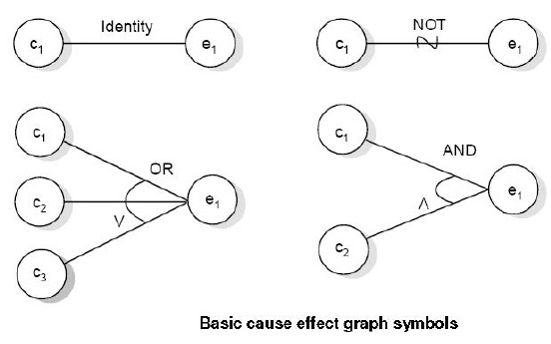
Cause Effect Graph Symbols

Slide 52
Example
Consider each node as having the value 0 or 1 where
0 represents the 'absent state' and
1 represents the 'present state'.
Then the identity function states that if c1 is 1, e1 is 1 or we can say if c0 is 0, e0 is 0.
The NOT function states that if C1 is 1, e1 is 0 and vice-versa.
The OR function states that if C1 or C2 or C3 is 1, e1 is 1 else e1 is 0.
The AND function states that if both C1, and C2 are 1, e1 is 1; else e1 is 0.
The AND and OR functions are allowed to have any number of inputs.

Slide 53
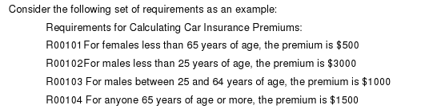
Example
What are the driving input variables?
What are the driving output variables?
Can you list the causes and the effects ?

Slide 54
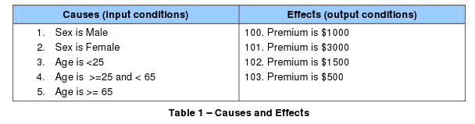
Example: Causes & Effects

Slide 55
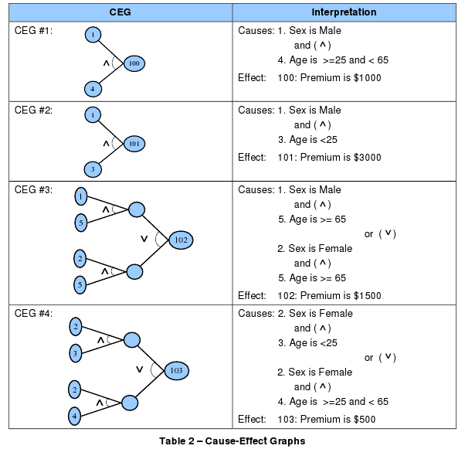
Step 3: Construct Cause & Effect Graph

Slide 56
Step 4: Annotate the graph with constraints
Annotate the graph with constraints describing combinations of causes and/or effects that are impossible because of syntactic or environmental constraints or considerations.
Example: Can be both Male and Female!
Types of constraints?
Exclusive: Can’t both be true
Inclusive: At least one must be true
One and only one: Exactly one must be true
Requires: If A implies B
Mask: If effect X then not effect Y

Slide 57
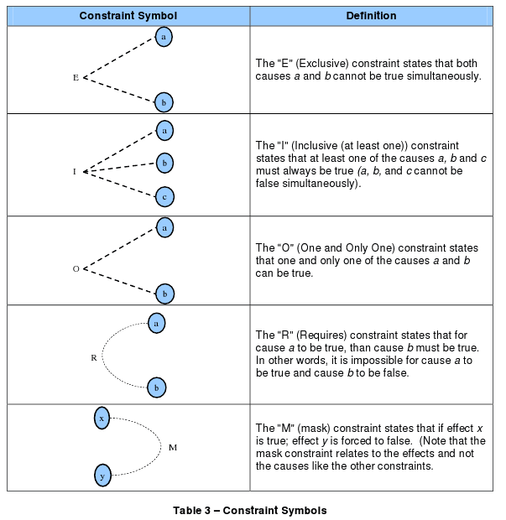
Types of Constraints

Slide 58
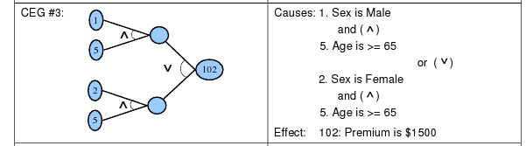
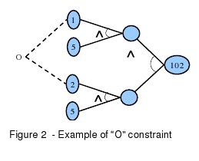
Example: Adding a One-and-only-one Constraint

Slide 59
Step 5: Construct limited entry decision table
Methodically trace state conditions in the graphs, converting them into a limited-entry decision table.
Each column in the table represents a test case.
Test Case | 1 | 2 | 3 | … | n
Cause 1 | 1 | 0 | …
… | 0 | 1 | …
Cause c | 0 | 0 | …
Effect 100 | … | … | …
…
Effect e |  |  |  |  | 0

Slide 60
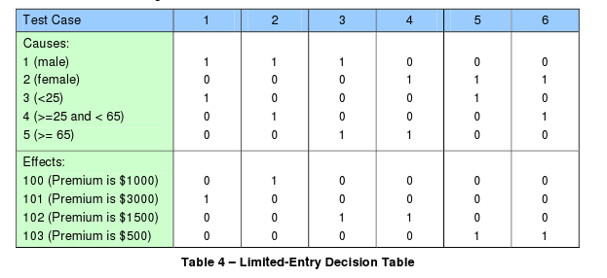
Example: Limited entry decision table

Slide 61
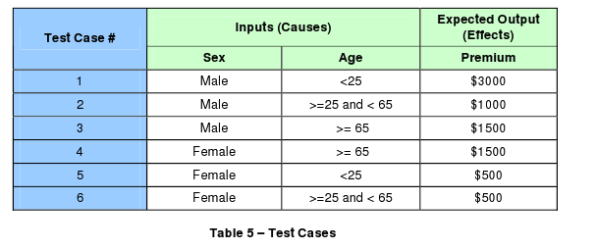
Step 6: Convert into test cases.
Columns to rows
Read off the 1’s

Slide 62
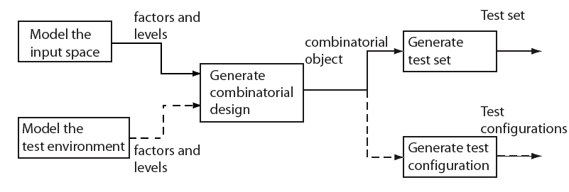
Combinatorial test design process
Modeling of input space or the environment is not exclusive and one might apply either one or both depending on the application under test.

Slide 63
Example: Pizza Delivery Service
A PDS takes orders online, checks for their validity, and schedules Pizza for delivery.
A customer is required to specify the following four items as part of the online order: Pizza size, Toppings list, Delivery address and a home phone number. Let us denote these four factors by S, T, A, and P, respectively.

Slide 64
Pizza Delivery Service (PDS): Specs
Suppose now that there are three varieties for size: Large, Medium, and Small.
There is a list of 6 toppings from which to select. In addition, the customer can customize the toppings.
The delivery address consists of customer name, one line of address, city, and the zip code. The phone number is a numeric string possibly containing the dash (``--") separator.

Slide 65
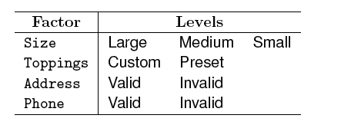
PDS: Input space model
The total number of factor combinations is 2⁴+2³=24.
Suppose we consider 6+1=7 levels for Toppings. Number of combinations= 2⁴+5x2³+2³+5x2²=84.
Different types of values for Address and Phone number will further increase the combinations

Slide 66
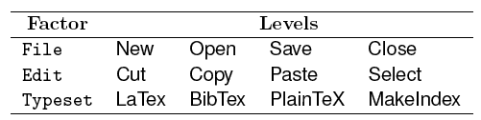
Example: Testing a GUI
The Graphical User Interface of application T consists of three menus labeled File, Edit, and Format.
We have three factors in T. Each of these three factors can be set to any of four levels. Thus we have a total 4³=64 factor combinations.

Slide 67
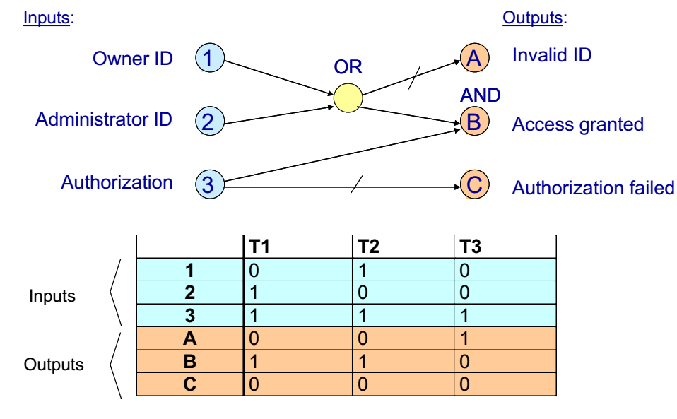
Cause-effects analysis

Slide 68
Guidelines for Cause-Effect Functional Testing Technique:
If the variables refer to physical quantities, domain testing and equivalence class testing are indicated.
If the variables are independent, domain testing and equivalence class testing are indicated.
If the variables are dependent, decision table testing is indicated.
If the single-fault assumption is warranted, boundary value analysis (BVA) and robustness testing are indicated.
If the multiple-fault assumption is warranted, worst-case testing, robust worst-case testing and decision table testing are identical.
If the program contains significant exception handling, robustness testing and decision table testing are indicated.
If the variables refer to logical quantities, equivalence class testing and decision table testing are indicated.

Slide 69
Questions answered by Black-box Testing
How is functional validity tested?
How are system behavior and performance tested?
What classes of input will make good test cases?
Is the system particularly sensitive to certain input values?
How are the boundary values of a data class isolated?
What data rates and data volume can the system tolerate?
What effect will specific combinations of data have on system operation?

Slide 70
Selecting a Black-box Testing Tool
When selecting a black-box testing tool there are several things to look for:
What platforms does it support?
How resilient is it to differences in the way images are rendered?
What facilities exist to aid in image recapture?
How does it identify images (by coordinates or image recognition)?
Whichever tool you choose, hopefully you recognize the importance of black-box testing in ensuring you are delivering applications that have been tested as they will be used and meet customer needs.

Slide 71
Example
Myer methodology, test cases can be designed for the Triangle Problem
Step – 1: First of all we need to identify the causes and its effects.
The causes designated by letter “C” are as under
C1 : Side “x” is less than sum of “y” and “z”
C2 : Side “y” is less than sum of “x” and “z”
C3 : Side “z” is less then sum of “x” and “y”
C4 : Side “x” is equal to side “y”
C5 : Side “x” is equal to side “z”
C6 : Side “y” is equal to side “z”

Slide 72
Example
The effects designated by letter “e” are as under
e1 : Not a triangle
e2 : Scalene triangle
e3 : Isosceles triangle.
e4 : Equilateral triangle
e5 : Impossible

Slide 73
Cause-effect analysis
Examining the relation of inputs and outputs (if it is simple, e.g., combinational)
Causes: input equivalence classes
Effects: output equivalence classes
Boole-graph: relations of causes and effects
AND, OR relations
Invalid combinations
Decision table: Covering the Boole-graph
Truth table based representation
Columns represent test data

Slide 74
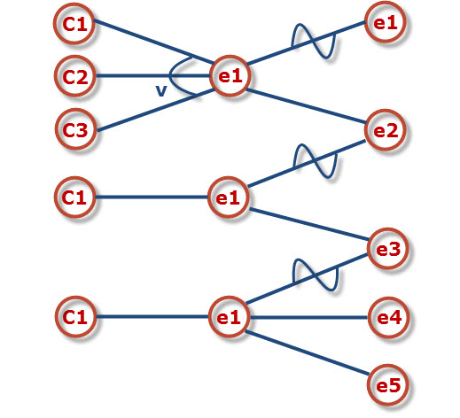
Example
Step 2: Build up a cause-effect graph

Slide 75
Example
Step 3: Convert cause-effect graph into a decision table
Conditions | R1 | R2 | R3 | R4 | R5 | R6 | R7 | R8 | R9 | R10 | R11
C1: X < Y+Z? | 0 | 1 | 1 | 1 | 1 | 1 | 1 | 1 | 1 | 1 | 1
C2: Y < X+Z? | X | 0 | 1 | 1 | 1 | 1 | 1 | 1 | 1 | 1 | 1
C3: Z < X+Y? | X | X | 0 | 1 | 1 | 1 | 1 | 1 | 1 | 1 | 1
C4: X=Y? | X | X | X | 1 | 1 | 1 | 1 | 0 | 0 | 0 | 0
C4: X=Z? | X | X | X | 1 | 1 | 0 | 0 | 1 | 1 | 0 | 0
C5: Y=Z? | X | X | X | 1 | 0 | 1 | 0 | 1 | 0 | 1 | 0
e1: Not a Triangle | 1 | 1 | 1
e2: Scalene |  |  |  |  |  |  |  |  |  |  | 1
e3: IsoScele |  |  |  |  |  |  | 1 |  | 1 | 1
e4: Equilateral |  |  |  | 1
e5: Impossible |  |  |  |  | 1 | 1 |  | 1

Slide 76
Example
Step 4: 11 test cases according to the 11 rules.
Test Case | X | Y | Z | Expected Result
1 | 4 | 1 | 2 | Not a triangle
2 | 1 | 4 | 2 | Not a triangle
3 | 1 | 2 | 4 | Not a triangle
4 | 5 | 5 | 5 | Equilateral
5 | ? | ? | ? | Impossible
6 | ? | ? | ? | Impossible
7 | 2 | 2 | 3 | Isosceles
8 | ? | ? | ? | Impossible
9 | 2 | 3 | 2 | Isosceles
10 | 3 | 2 | 2 | Isosceles
11 | 3 | 4 | 5 | Scalene

